Slide 1

Data Flow Diagrams
Based on 3 Milestones

Slide 2
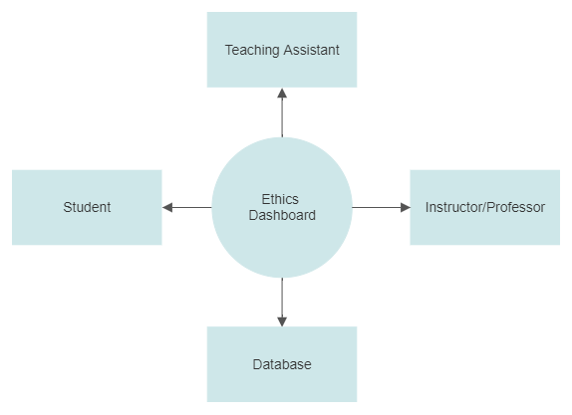
Context Diagram/Data Flow Diagram Level 0

Slide 3
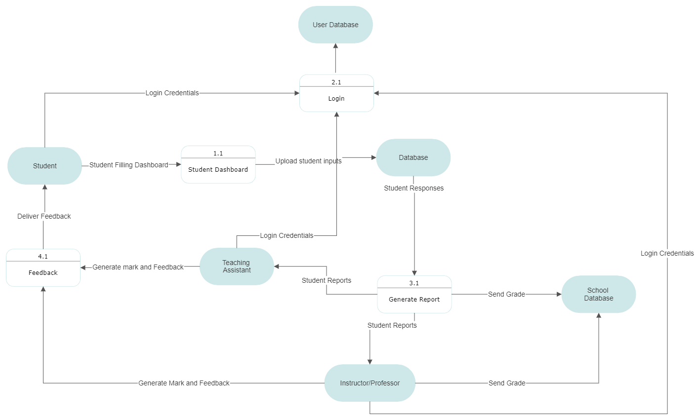
Data Flow Diagram Level 1

